Slide 1

Anomaly Detection in vessel traffic
A SAAB production

Slide 2
Contents
Endgoals
How to reach our goals
Main Research Question
Literature study
NDA’s
Emergency Extracted AIS data
Informational poster
Product Backlog

Slide 3


Endgoals
Create a working prototype of an anomaly detection system
Create publishable research

Slide 4




How to reach our goals
Literature study
Explore data
Recurrent Neural Networks/LSTM
Small dataset, expand later

Slide 5

Research question
How suitable are Recurrent Neural Networks with Long Short-term Memory to detect anomalies in vessel traffic data in real-time?
UNDER CONSTRUCTION

Slide 6
Sub Questions
What are anomalies in vessel traffic?
What is a Neural Network?
What is a Recurrent Neural Network?
What is Long Short-term Memory?
How can we use RNN with LSTM to detect anomalies?
How does this compare to other anomaly detection methods?
What are other anomaly detection methods?
ALSO UNDER CONSTRUCTION

Slide 7


Literature study
15 Papers total, 6 chosen by Jordi, at least 2 papers each
Use of Powerpoint presentations
Concept Literature
Contains our points of interest

Slide 8


NDA’s
STILL ONGOING
SCHOOL’S LEGAL DEPARTMENT

Slide 9

Emergency Extracted AIS data
No data?
We create our own data!

Slide 10
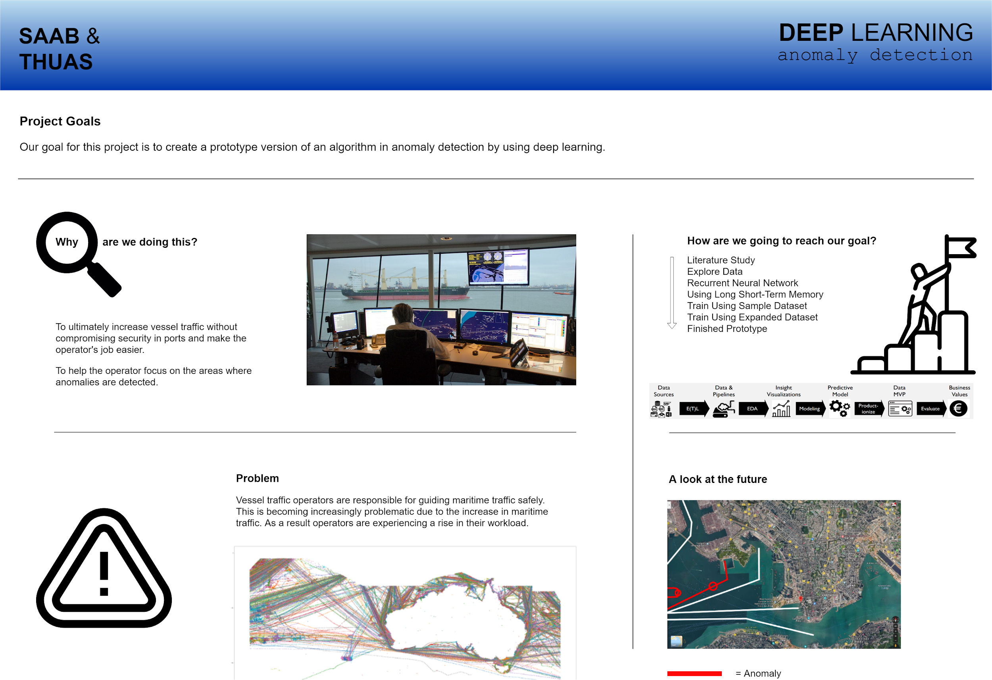
Informational poster

Slide 11
Product Backlog
Literature Study | As the product owner I want every point of the Scribbr manual to be included in the literature study; As the product owner I want to have a thorough research done by the project team, using at least 15 different literature studies that are all interconnected; As the product owner I want to have a literature study that is written in proper, scientific English with a max of 1 spelling/style error per page; As the product owner I want to have a literature study that is a good foundation for the potential publishable research that will be the end goal (next to the prototype).
Research | As a researcher I want a solid (SMART)research question so that we have a goal to build towards. As a researcher I want to define sub questions so we can answer our main question. As a researcher I want to write an introduction for the research by using the knowledge we gained from our literature study & our prototype. As a researcher I want to write about materials and methods used for the research by using the knowledge we gained from our literature study & our prototype. As a researcher I want to write the results we found for the research by using the knowledge we gained from our literature study & our prototype. As a researcher I want to write a conclusion for the research by using the knowledge we gained from our literature study & our prototype. As a researcher I want to write a discussion for possible next research by using the knowledge we gained from our literature study & our prototype. As a researcher I want to write an abstract for the research by using the knowledge we gained from our literature study & our prototype.
EPICS | User Stories
Anomaly Detector Prototype | As a user I want to be able to see alerts that are generated by the anomaly detector; As a user I want to be able to hear alerts that are generated by the anomaly detector; As a user I want to hover my mouse over the generated alert and see more information about anomaly, so I can act accordingly; As a user I want to click on the generated alert to assign it to multiple labels (anomaly seen, anomaly solved, anomaly inaccurate); As a user I want to be able to remove the generated alert by right-clicking on the alert in the anomaly detector.
Recurrent Neural Network Design | As the product owner I want to be able to see the design of the recurrent neural network that uses long short term memory; As the product owner I want to see in the design what features are used for training and predicting the data.
Implementing Recurrent Neural Network Research | As the product owner I want to use good practices that are researched by other researchers so the project has a head start instead of researching everything from the beginning; As a developer I want to experiment with Recurrent Neural Networks and Long Short-Term Memory to know how to use it; As the product owner I want to see a Recurrent Neural Network successfully implemented; As the product owner I want to see a Recurrent Neural Network with Long Short-Term Memory to be successfully implemented in the prototype; As the product owner I want to know the recall, precision and accuracy of the neural net; As the product owner I want to have the algorithm trained with a training data set of 70% and a testing data set of 30%.

Slide 12
Any Questions?
No? Okay.

Slide 13
Thank you!

